Slide 1
Open Source Software Engineering
SE ZG587
Session 4
Kumar Manish
12th August, 2023

Slide 2
Understanding Software Licenses in OSS

Slide 3
Software Licenses
A software License is a Legal instrument which describes the manner in which a software can be used or redistributed - in both source code or object code forms.
A typical software license grants the Licensee ( end-user) , the permission to the software in a manner where such a use would otherwise potentially constitute copyright Infringement of the software owner's exclusive rights.
Software Licensing Models :
  Copyrights
  Copyleft Licenses - Protective
  Permissive Licenses - More free
  Creative Commons Licenses - Public copyrights licenses

Slide 4
Copyrights
Copyright is an important intellectual property license that gives the owner an exclusive right on the work crated by him / her. The owner is allowed to create copies of the creative work
The creative work may be of any type - including literary artistic, educational, or musical form
As a general rule , for works created after January 1, 1978 , copyright protection lasts for the life of the author plus a additional 70 years.
In case of a corporate authors , the protection is for the shorter of 95 years from publication or 120 years from creation

Slide 5
Copyleft
Copyleft is a licensing method,
  used to make a work ( or program ) free to use, modify , adapt or extend
  The freedom to carry out all activities , as aligned with the four essential freedoms ( prerequisite – source code available)
  Copy left licenses includes the GNU general public license ( GPL) – which was originally written by Richard Stallman
  the work or program should be made available to the recipients - Mostly in the form of source code
No re-licensing allowed, No commercial usage allowed
All modified and extended version of the work ) or program ) should be free as well - hence called protective licenses
Rules for copyleft –
  all derivative works should be attributed to the creator, open sourced and copyleft
Copyleft is a generic concept , and can’t be used directly ; one needs to use a specific implementations of the concepts

Slide 6
Variants of Copyleft
Strong and Weak copyleft : The strength of the copyleft license is decided based on the extent its provision are imposed on the derived works
Examples :
  Strong Copyleft :
    GNU general public License
  Weak copyleft
    GNU Lesser General Public License –
    Mozilla public license
Weak copyleft licensing :
Most commonly, weak copyleft licenses are used to create Software Libraries
Help software to link to the library and redistributed without requirement for the linking software to also be copyleft –licensed

Slide 7
Copyleft – share alike condition
Share-alike :
Imposes the requirement that any freedom that is granted regarding the original work must be granted on exactly the same or compatible terms in all derived work
However, in some cases the author may be willing to share only a certain part of the work, but the share – alike agreement require that the whole body of the work is shared
The positive side – for an author of source code – any modification to the code will not only benefit the original creator, but that the author will be attributed and recognised and hold equal claim over the changed code.

Slide 8
Permissive Licenses
Free software licenses with only minimal restrictions on how the software can be used , modified and redistributed ( also called Berkeley software distribution : BSD-like or style licenses )
Rules for usage - what ever user wants , but with few restrictions – derived works must be attributed to the creator
Source code need not be open or made available in the public domain
Re-licensing allowed - derivative works can be release under any other licenses or used as proprietary products
Allows commercial usage
Examples :
  GNU All permissive License
  MIT License
  BSD licenses
  Apple Public source licenses
  Apache license

Slide 9
Comparing Permissive and Copyleft
Copyleft (Protective Licenses ) | Permissive Licenses
Publication of software code of all modified versions or derived works under the original copyleft licenses - protective licenses | Provides No guarantee that derived works of the software will remain free and publicly available ; generally requiring only that the original copyrights notice be remained
 | Hence derived works , or future versions , of permissively – licenses software can be released as proprietary software Permissive licenses offer highly extensive license compatibility as compared to copyleft licenses Wider adaptability in the open source community

Slide 10
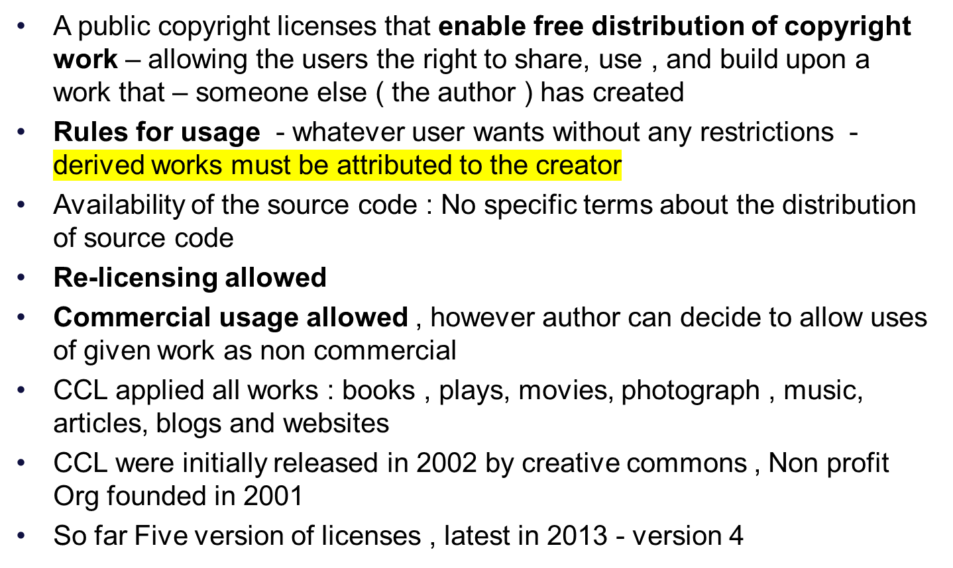
Creative Common Licenses ( CCL)

Slide 11
Creative Commons Licenses
Compatibility with software :
Not recommended for use for software - since they do not contain specific terms about the distributions of source code, which is important in order to ensure the free reuse and modifiability of software
Most of the CC licenses are not compatible with the major software licenses , so it would be difficult to integrate CC licenses work with other free software
However, they may be used for software documentations , or other artistic elements embedded within documentation.
Free Software Foundations (FSF) : In 2011 added “CC 0 version”
Open Source Initiative (OSI) : Not approved under OSI because of its clause which excluded from the scope of the licenses any relevant patents held by the copyrights holder.

Slide 12
How to choose an open source License ?
Open source licenses help in protecting works contributed in the open source domain
It also help protect contributors and users from any copyright infringements
Interested developers or contributors or business will not touch a project without a license protection.
Which license should I choose :
If I wish to work with a community
If I wish to keep the licenses simple and permissive
If I wish to share the improvements made
If I wish to work without license

Slide 13
Recap
Intellectual Property Rights and Software Licenses
Licensing Models in OSS:
  Copyright,
  Copyleft,
  Permissive,
  Creative Commons

Slide 14
Understanding and Choosing Open Source Licensing Models

Slide 15
Choosing Open Source Licensing Models
Option 1: Work with a community
Option 2: Keep it simple and permissive
Option 3: Need to share improvements
Option 4: Work without a license

Slide 16
How to choose an open source License ?
Why to choose ?
Open source licenses help in protecting works contributed in the open source domain
It also help protect contributors and users from any copyright infringements
Interested developers or contributors or business will not touch a project without a license protection.
Which License should I choose :
If I wish to work with a community
If I wish to keep the license simple and permissive
If I wish to share the improvements made
If I wish to work without a license

Slide 17
Work with a community
To contribute to or modify or adapt an existing projects,
  Continue contributions using original license available with the project
Moreover, using the same license might also be a requirement
  as per stated in the original license terms of the project
Look at LICENSE or COPYING or README file for more info
Certain Open source software projects require contributors to sign the Contributors License Agreement (CLA)
  Simple CLAs vs Detailed CLAs
  Individual CLAs vs Corporate CLAs
No centralised body of knowledge engaged in standardizations of CLAs
  Different organisations write their own versions
  Larger project need formal CLAs
  Generally baked by one or more corporations
    Ex – Apache, Django, Eclipse Foundations etc

Slide 18
Work with a community
Normally, a CLA require the contributors to make certain classifications ( In terms of legal proofs) , which may comprise of one or more of the following :
  the contributors is the author of the contributions;
  the contribution is an original work;
  the contribution is not subject to third – party license , claims etc;
  the contribution has the legal right to grant the copyright license;
  the contributors does not have an employer that can claim rights in the copyright;
Benefits of CLA : protection against copyright infringement
Disadvantages : discourage contributions

Slide 19
Work with a community
How to manage the ownership and licensing of copyrights for individual software contributors to the project ?
  Option 1 : The author ( who is also, by default, the copyright holder) of the software contributions retains the software ‘s copyright and ownership and contributes it under the same open source license as used by the project.
  Option 2 : The contributors assigns the ownership of the software copyright to The “Project Maintainer”. Who then releases the software under the projects’ Open Source License.
  Option 3 : the last option is not to define any ownership policy

Slide 20
Keep it simple and permissive
Choose the MIT License :
  It is a short and simple permissive license with condition only requiring preservation of copyright and license notices.
Licensed works, modification and larger works may be distributed under different terms and without source code.
The MIT license allows users the permission to reuse code for any purpose , or embed it as a part of proprietary software or make any changes or modifications to the code to suit their needs.
Restrictions - users are required to include the original copy of the MIT licenses

Slide 21
Keep it simple and permissive
Permissions :
  Commercial Use : the licenses materials and derivatives may be used for commercial purposes
  Distribution : The licensed materials may be distributed
  Modification : The licensed materials may be modified
  Private use : The licensed materials may be used and modified in private
Conditions :
  A copy of the license and copyright notice MUST be included with the license materials.
Limitations :
  Liability : The license includes a limitation of liability
  Warranty : The license explicitly states that it does NOT provide any warranty

Slide 22
Need to share improvements
Choose the GNU general Public Licenses v3.0 – copyleft license - protective license
This strong copyleft license provisions on making available complete source code of licensed works and modifications, including larger works under the same license.
Copyright and license notice Must be preserved.
Contributors provides an express grant of patent rights.
GPL assures that patent can not be used to render the program non free.

Slide 23
Need to share improvements
Permissions :
  Commercial use : The licensed materials and derivates may be used for commercial purposes.
  Distributions : the licensed materials may be distributed.
  Modification : The licensed materials may be modified
  Private use: The license materials may be used and modified in private
  Patent use : the license provides an express grants of patent rights from contributors
Limitation :
  Liability : The license includes a limitation of liability
  Warranty : The license explicitly states that it does NOT provide any warranty

Slide 24
Need to share improvements
Conditions :
Disclose source : Source code MUST be made available when the licensed materials is distributed.
License and copyright notice : A copy of the license and copyright notice Must be include with the license material.
Same license : Modifications Must be released under the same license when distributing the licensed materials . In some cases a similar or released license may be used.
State Changes : Changes made to the licensed materials Must be documented

Slide 25
Work without a license
By default, all works are under exclusive copyrights of the creator – be it creative work or code
Unless a license is associated with the copyrighted works, that states otherwise , no one can copy , distribute, or modify the work without being at risk of copyright infringement
However , in the absence of a license file , one may still grant some rights – the holds in cases where one publishes the source code on a site that requires accepting terms of service
For example , if the source code is published in a public repository on GitHub, and you have accepted their terms of service , by this you allow others to view and fork your repository

Slide 26
Work without a license
You do not have to do anything to work without a license
  However, in the case , one may wish to add a copyright notice and statement - indicating that no license has been included - in a prominent place – e.g. the project READADME
Moreover, disallowing the use of your code might not be what you actually intent by “ no license”
  An open source license allows reuse of your code while retaining copyright.
  Add a contributors license agreement (CLA) to your non-licensed project, so that you maintain copyright permission from contributors, even though you are not granting the same.

Slide 27
Work without a license
To use or contribute to project that has no license associated with it
Do not use the software : Find or create an alternative that is under an open source license
Request the Project Maintainers to add a license :
  Unless the software included strong indications to the contrary, lack of a license is probably an oversight.
    If the software is hosted on a site like GitHub, open an issue requesting a license
    If you are sure what license is most appropriate, open a pull request to add a license - with a suggestive license

Slide 28
References and further readings
Choose a license https://choosealicense.com/
Open Source Initiative https://opensource.org/
Open Source Resources https://opensource.com/
Open Source Guides (https://opensource.guide/
Creative commons https://creativecommons.org
GNU https://www.gnu.org/
Copyleft https://copyleft.org/

